Slide 1
TriceptionNet: An Ensemble Learning Based
Approach For Facial Emotion Recognition
Submitted in the partial fulfillment for the award of the degree of
BACHELOR OF ENGINEERING
IN
COMPUTER SCIENCE ENGINEERING (AIML)
Submitted by:
Shabeer: 21BCS6001
Akshay: 21BCS5849
Under the Supervision of:
Mr. Rosevir Singh
Department of AIT-CSE
DISCOVER . LEARN . EMPOWER

Slide 2
INDEX
1. INTRODUCTION
2. OBJECTIVES
3. RESEARCH METHODOLOGY
4. LITERATURE REVIEW
5. REQUIREMENTS
6. DESIGN CONSTRAINTS
7. DATA COLLECTION PLAN

Slide 3
INTRODUCTION
Facial emotion recognition (FER) plays a critical role in applications such as mental health assessment, human-computer interaction, and security systems. Traditional approaches to emotion recognition, which relied on manually crafted features and simple classification methods, often fall short in handling the complexities of real-world facial expressions. However, recent advancements in deep learning, particularly with Convolutional Neural Networks (CNNs), have brought significant improvements to the field, allowing for more accurate and robust emotion detection. In this study, we introduce TriceptionNet, an ensemble model that combines the strengths of EfficientNetB0, InceptionResNetV2, and ResNet50 to enhance accuracy and reliability in FER. Trained on the FER2013 dataset, which includes over 30,000 images spanning seven emotions, TriceptionNet demonstrates the potential of ensemble learning to leverage multiple models for improved performance in emotion recognition tasks. This approach underscores the importance of ensemble techniques in achieving high accuracy for complex classification challenges like facial emotion recognition.

Slide 4
OBJECTIVES
Introduce TriceptionNet
Present a novel ensemble model combining EfficientNetB0, InceptionResNetV2, and ResNet50 for Facial Emotion Recognition (FER).
Implementation of Ensemble Learning
Demonstrate how combining multiple CNN models can improve accuracy and robustness in emotion recognition tasks.
Describe Model Architecture and Methodology
Outline the training process and structure of TriceptionNet, highlighting the use of a Multi-Layer Perceptron (MLP) as a meta-classifier.
Evaluate Model Performance
Share experimental results on the FER2013 dataset, including accuracy, precision, recall, and F1-score of the ensemble model.
Highlight the Significance of Results
Discuss how TriceptionNet’s improved performance can benefit applications in mental health, human-computer interaction, and security.
Provide Insights for Future Research
Suggest potential directions for further exploration, such as experimenting with additional ensemble strategies and hybrid architectures.

Slide 5
RESEARCH METHODOLOGY
Dataset and Preprocessing
FER2013 dataset (~35,000 images across 7 emotions), resized to 100x100, normalized, and label-encoded.
Model Architecture
Base Models: EfficientNetB0, InceptionResNetV2, ResNet50, with custom Global Average Pooling and dense layers.
Ensemble Design
Meta-Classifier: Multi-Layer Perceptron (MLP) combines outputs from all three CNNs.
Training
Trained each model for 50 epochs with SGD and adaptive learning rate.
Evaluation
Measured accuracy, precision, recall, and F1-score on test data.

Slide 6
LITERATURE REVIEW
Traditional FER Methods
Early methods relied on manual feature extraction and simple classifiers, but struggled with real-world accuracy.
Deep Learning Advancements
Kahou et al. (2017): Demonstrated the effectiveness of CNNs for FER on the FER2013 dataset, setting a foundation for deep learning in emotion recognition.
Ensemble and Hybrid Models
Zhang et al. (2018): Improved FER accuracy by ensembling multiple CNN models.
Gao et al. (2020): Combined CNNs with RNNs for video-based FER, capturing temporal dynamics of emotions.
Attention Mechanisms and Transfer Learning
Li et al. (2019): Used attention mechanisms to focus on facial features, enhancing FER accuracy.
Mollahosseini et al. (2017): Showed the benefits of transfer learning with pre-trained models like VGG-16 and ResNet50 for FER.
Ensemble Learning for Enhanced Performance
Kim et al. (2022): Demonstrated improved results by ensembling diverse CNN architectures, a strategy also used in this study for robust emotion recognition.

Slide 7
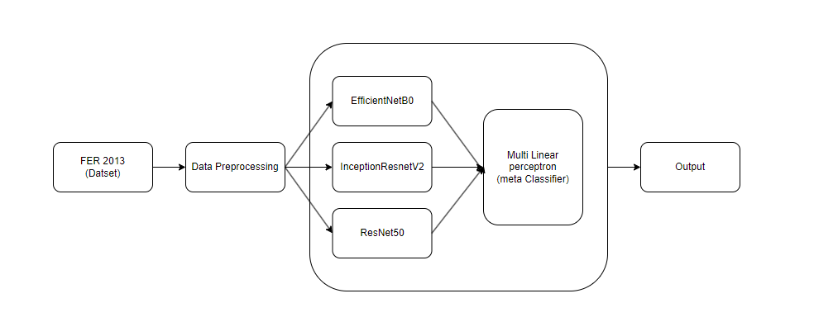
Proposed System Architecture

Slide 8
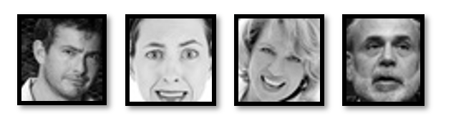
Sample Images From Fer 2013 Dataset

Slide 9
Required Equipment
Hardware
GPU: NVIDIA GPU (GTX 1050) for efficient deep learning model training.
CPU: Multi-core processor (Intel i5) for handling preprocessing and data loading tasks.
Memory:16GB RAM to support large dataset processing.
Storage: SSD with 500GB to manage dataset and model storage.
Software
Programming Language: Python for model development.
Deep Learning Libraries: TensorFlow or PyTorch for implementing and training neural networks.
Data Processing Libraries: NumPy, Pandas, and OpenCV for data manipulation and image processing.
IDE/Notebook: Jupyter Notebook or PyCharm for code development and testing.
Version Control: Git for tracking code changes and collaboration.
Operating System: Windows, optimized for deep learning environments.

Slide 10
DESIGN CONSTRAINTS
Data Variability
Facial expressions can vary across individuals, lighting conditions, and angles, making it challenging to achieve high accuracy.
Model Complexity
Balancing model complexity and training time. Large models like EfficientNetB0, ResNet50, and InceptionResNetV2 require significant computational resources.
Class Imbalance
Some emotions (e.g., "fear" or "disgust") may have fewer samples in the dataset, affecting model performance on these classes.
Generalization
Ensuring the model generalizes well to unseen data, as the FER2013 dataset might not represent every demographic or real-world scenario.
Hardware Limitations
High-end GPUs required for efficient training and inference, limiting accessibility on standard hardware setups.

Slide 11
Results
Model | Accuracy
EfficientNetB0 | 0.6524
InceptionResNetV2 | 0.6169
ResNet50 | 0.6304
Class | Precision | Recall | F1-Score | Support
0 | 0.80 | 0.77 | 0.79 | 831
1 | 0.55 | 0.48 | 0.52 | 1024
2 | 0.61 | 0.58 | 0.59 | 958
3 | 0.63 | 0.62 | 0.62 | 1233
4 | 0.52 | 0.59 | 0.55 | 1247
5 | 0.83 | 0.54 | 0.66 | 111
6 | 0.83 | 0.88 | 0.86 | 1774
Macro Average | 0.68 | 0.64 | 0.65 | 7178
Weighted Average | 0.67 | 0.67 | 0.67 | 7178
By leveraging the unique strengths of each model, the ensemble significantly outperformed the individual models, achieving an overall accuracy of 67%

Slide 12
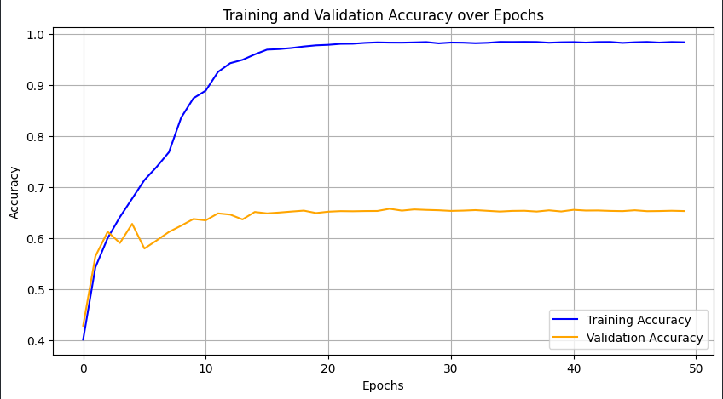
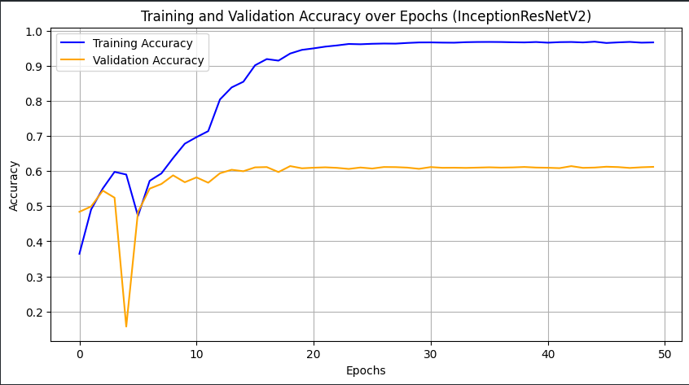
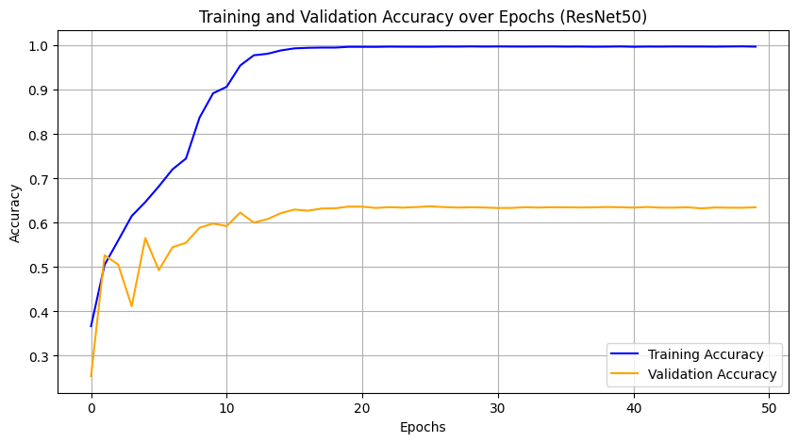
EfficientNetB0
InceptionResNetV2
ResNet50

Slide 13
Conclusion
Demonstrated the effectiveness of an ensemble-based approach for facial emotion recognition, combining EfficientNetB0, ResNet50, and InceptionResNetV2.
Leveraged the unique strengths of each model to achieve an overall accuracy of 67%, outperforming individual models.
Utilized a Multi-Layer Perceptron (MLP) as a meta-classifier to effectively combine base model outputs, boosting performance for challenging emotion classes.
Results highlight ensemble learning's potential to improve emotion detection accuracy for real-world applications.
Proposed future exploration of advanced ensemble strategies and hybrid architectures to enhance performance and address remaining challenges.
Paves the way for more accurate and reliable emotion recognition systems applicable in human-computer interaction, healthcare, and security.

Slide 14
THANK YOU

